Slide 1
Course Overview 15-213/18-213/15-513: Introduction to Computer Systems 1st Lecture, Aug 30, 2016
Instructors:
Randy Bryant
Martin Carlisle
Phil Gibbons
Brian Railing
The course that gives CMU its “Zip”!

Slide 2
Overview
Big Picture
Course theme
Five realities
How the course fits into the CS/ECE curriculum
Academic integrity
Logistics and Policies

Slide 3
The Big Picture

Slide 4
Course Theme: (Systems) Knowledge is Power!
Systems Knowledge
How hardware (processors, memories, disk drives, network infrastructure) plus software (operating systems, compilers, libraries, network protocols) combine to support the execution of application programs
How you as a programmer can best use these resources
Useful outcomes from taking 213/513
Become more effective programmers
Able to find and eliminate bugs efficiently
Able to understand and tune for program performance
Prepare for later “systems” classes in CS & ECE
Compilers, Operating Systems, Networks, Computer Architecture, Embedded Systems, Storage Systems, etc.

Slide 5
It’s Important to Understand How Things Work
Why do I need to know this stuff?
Abstraction is good, but don’t forget reality
Most CS and CE courses emphasize abstraction
Abstract data types
Asymptotic analysis
These abstractions have limits
Especially in the presence of bugs
Need to understand details of underlying implementations
Sometimes the abstract interfaces don’t provide the level of control or performance you need

Slide 6
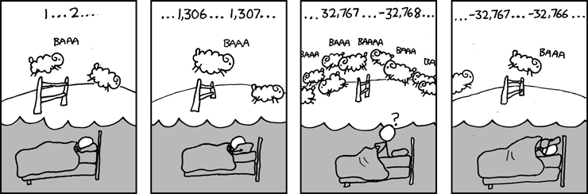
Great Reality #1: Ints are not Integers, Floats are not Reals
Example 1: Is x² ≥ 0?
Float’s: Yes!
Int’s:
40000 * 40000 --> 1600000000
50000 * 50000 --> ?
Example 2: Is (x + y) + z = x + (y + z)?
Unsigned & Signed Int’s: Yes!
Float’s:
(1e20 + -1e20) + 3.14 --> 3.14
1e20 + (-1e20 + 3.14) --> ??
Source: xkcd.com/571

Slide 7
Computer Arithmetic
Does not generate random values
Arithmetic operations have important mathematical properties
Cannot assume all “usual” mathematical properties
Due to finiteness of representations
Integer operations satisfy “ring” properties
Commutativity, associativity, distributivity
Floating point operations satisfy “ordering” properties
Monotonicity, values of signs
Observation
Need to understand which abstractions apply in which contexts
Important issues for compiler writers and serious application programmers

Slide 8
Great Reality #2: You’ve Got to Know Assembly
Chances are, you’ll never write programs in assembly
Compilers are much better & more patient than you are
But: Understanding assembly is key to machine-level execution model
Behavior of programs in presence of bugs
High-level language models break down
Tuning program performance
Understand optimizations done / not done by the compiler
Understanding sources of program inefficiency
Implementing system software
Compiler has machine code as target
Operating systems must manage process state
Creating / fighting malware
x86 assembly is the language of choice!

Slide 9
Great Reality #3: Memory Matters Random Access Memory Is an Unphysical Abstraction
Memory is not unbounded
It must be allocated and managed
Many applications are memory dominated
Memory referencing bugs especially pernicious
Effects are distant in both time and space
Memory performance is not uniform
Cache and virtual memory effects can greatly affect program performance
Adapting program to characteristics of memory system can lead to major speed improvements

Slide 10
Memory Referencing Bug Example
typedef struct {
int a[2];
double d;
} struct_t;
double fun(int i) {
volatile struct_t s;
s.d = 3.14;
s.a[i] = 1073741824; /* Possibly out of bounds */
return s.d;
}
fun(0) --> 3.14
fun(1) --> 3.14
fun(2) --> 3.1399998664856
fun(3) --> 2.00000061035156
fun(4) --> 3.14
fun(6) --> Segmentation fault
Result is system specific

Slide 11
Memory Referencing Bug Example
typedef struct {
int a[2];
double d;
} struct_t;
fun(0) --> 3.14
fun(1) --> 3.14
fun(2) --> 3.1399998664856
fun(3) --> 2.00000061035156
fun(4) --> 3.14
fun(6) --> Segmentation fault
Explanation:
Critical State | 6
? | 5
? | 4
d7 ... d4 | 3
d3 ... d0 | 2
a[1] | 1
a[0] | 0
Location accessed by fun(i)
struct_t

Slide 12
Memory Referencing Errors
C and C++ do not provide any memory protection
Out of bounds array references
Invalid pointer values
Abuses of malloc/free
Can lead to nasty bugs
Whether or not bug has any effect depends on system and compiler
Action at a distance
Corrupted object logically unrelated to one being accessed
Effect of bug may be first observed long after it is generated
How can I deal with this?
Program in Java, Ruby, Python, ML, …
Understand what possible interactions may occur
Use or develop tools to detect referencing errors (e.g. Valgrind)

Slide 13
Great Reality #4: There’s more to performance than asymptotic complexity
Constant factors matter too!
And even exact op count does not predict performance
Easily see 10:1 performance range depending on how code written
Must optimize at multiple levels: algorithm, data representations, procedures, and loops
Must understand system to optimize performance
How programs compiled and executed
How to measure program performance and identify bottlenecks
How to improve performance without destroying code modularity and generality

Slide 14
Memory System Performance Example
void copyij(int src[2048][2048],
int dst[2048][2048])
{
int i,j;
for (i = 0; i < 2048; i++)
for (j = 0; j < 2048; j++)
dst[i][j] = src[i][j];
}
void copyji(int src[2048][2048],
int dst[2048][2048])
{
int i,j;
for (j = 0; j < 2048; j++)
for (i = 0; i < 2048; i++)
dst[i][j] = src[i][j];
}
4.3ms
81.8ms
2.0 GHz Intel Core i7 Haswell
Hierarchical memory organization
Performance depends on access patterns
Including how step through multi-dimensional array

Slide 15
Why The Performance Differs
copyij
copyji

Slide 16
Great Reality #5: Computers do more than execute programs
They need to get data in and out
I/O system critical to program reliability and performance
They communicate with each other over networks
Many system-level issues arise in presence of network
Concurrent operations by autonomous processes
Coping with unreliable media
Cross platform compatibility
Complex performance issues

Slide 17
Course Perspective
Most Systems Courses are Builder-Centric
Computer Architecture
Design pipelined processor in Verilog
Operating Systems
Implement sample portions of operating system
Compilers
Write compiler for simple language
Networking
Implement and simulate network protocols

Slide 18
Course Perspective (Cont.)
Our Course is Programmer-Centric
By knowing more about the underlying system, you can be more effective as a programmer
Enable you to
Write programs that are more reliable and efficient
Incorporate features that require hooks into OS
E.g., concurrency, signal handlers
Cover material in this course that you won’t see elsewhere
Not just a course for dedicated hackers
We bring out the hidden hacker in everyone!

Slide 19
Role within CS/ECE Curriculum
CS 418
Parallel
CS 412
OS Practicum
ECE 545/549
Capstone
CS 415
Databases
CS 441
Networks
CS 410
Operating
Systems
CS 411
Compilers
ECE 340
Digital
Computation
ECE 447
Architecture
ECE 349
Embedded
Systems
ECE 348
Embedded
System Eng.
Data Reps.
Memory Model
Network
Protocols
Processes
Mem. Mgmt
Machine
Code
Arithmetic
Execution Model
Memory System
CS 440
Distributed
systems
Network Prog
Concurrency
213/513
Foundation of Computer Systems Underlying principles for hardware, software, and networking
CS 122
Imperative
Programming

Slide 20
Academic Integrity
Please pay close attention, especially if this is your first semester at CMU

Slide 21
Cheating/Plagiarism: Description
Unauthorized use of information
Borrowing code: by copying, retyping, looking at a file
Describing: verbal description of code from one person to another.
Searching the Web for solutions
Copying code from a previous course or online solution
Reusing your code from a previous semester (here or elsewhere)
If specific to 213/513, and you received credit

Slide 22
Cheating/Plagiarism: Description (cont.)
Unauthorized supplying of information
Providing copy: Giving a copy of a file to someone
Providing access:
Putting material in unprotected directory
Putting material in unprotected code repository (e.g., Github)
Applies to this term and the future
There is no statute of limitations for academic integrity violations

Slide 23
Cheating/Plagiarism: Description
What is NOT cheating?
Explaining how to use systems or tools
Helping others with high-level design issues
Using code supplied by us
Using code from the CS:APP web site
See the course syllabus for details.
Ignorance is not an excuse

Slide 24
Cheating: Consequences
Penalty for cheating:
Best case: -100% for assignment
You would be better off to turn in nothing
Worst case: Removal from course with failing grade
This is the default
Permanent mark on your record
Loss of respect by you, the instructors and your colleagues
If you do cheat – come clean asap!
Detection of cheating:
We have sophisticated tools for detecting code plagiarism
In Fall 2015, 20 students were caught cheating and failed the course.
Some were expelled from the University
In January 2016, 11 students were penalized for cheating violations that occurred as far back as Spring 2014.
Don’t do it!
Manage your time carefully
Ask the staff for help when you get stuck

Slide 25
Some Concrete Examples:
This is Cheating:
Searching the internet with the phrase 15-213, 15213, 213, 18213, malloclab, etc.
That’s right, just entering it in a search engine
Looking at someone’s code on the computer next to yours
Giving your code to someone else, now or in the future
Posting your code in a publicly accessible place on the Internet, now or in the future
Hacking the course infrastructure
This is OK (and encouraged):
Googling a man page for fputs
Asking a friend for help with gdb
Asking a TA or course instructor for help, showing them your code, …
Looking in the textbook for a code example
Talking about a (high-level) approach to the lab with a classmate

Slide 26
How it Feels: Student and Instructor
Fred is desperate. He can’t get his code to work and the deadline is drawing near. In panic and frustration, he searches the web and finds a solution posted by a student at U. Oklahoma on Github. He carefully strips out the comments and inserts his own. He changes the names of the variables and functions. Phew! Got it done!
The course staff run checking tools that compare all submitted solutions to the solutions from this and other semesters, along with ones that are on the Web.
Remember: We are as good at web searching as you are
Meanwhile, Fred has had an uneasy feeling: Will I get away with it? Why does my conscience bother me?
Fred gets email from an instructor: “Please see me tomorrow at 9:30 am.”
Fred does not sleep well that night

Slide 27
How it Feels: Student and Instructor
The instructor feels frustrated. His job is to help students learn, not to be police. Every hour he spends looking at code for cheating is time that he cannot spend providing help to students. But, these cases can’t be overlooked
At the meeting:
Instructor: “Explain why your code looks so much like the code on Github.”
Fred: “Gee, I don’t know. I guess all solutions look pretty much alike.”
Instructor: “I don’t believe you. I am going to file an academic integrity violation.”
Fred will have the right to appeal, but the instructor does not need him to admit his guilt in order to penalize him.
Consequences
Fred may (most likely) will be given a failing grade for the course
Fred will be reported to the university
A second AIV will lead to a disciplinary hearing
Fred will go through the rest of his life carrying a burden of shame
The instructor will experience a combination of betrayal and distress

Slide 28
A Scenario: Cheating or Not?
Alice is working on malloc lab and is just plain stuck. Her code is seg faulting and she doesn't know why. It is only 2 days until malloc lab is due and she has 3 other assignments due this same week. She is in the cluster.
Bob is sitting next to her. He is pretty much done.
Sitting next to Bob is Charlie. He is also stuck.
1. Charlie gets up for a break and Bob makes a printout of his own code and leaves it on Charlie’s chair.
Who cheated: Charlie? Bob?
2. Charlie finds the copy of Bob’s malloc code, looks it over, and then copies one function, but changes the names of all the variables.
Who cheated: Charlie? Bob?

Slide 29
Another Scenario
Alice is working on malloc lab and is just plain stuck. Her code is seg faulting and she doesn't know why. It is only 2 days until malloc lab is due and she has 3 other assignments due this same week. She is in the cluster.
Bob is sitting next to her. He is pretty much done.
Sitting next to Bob is Charlie. He is also stuck.
1. Bob offers to help Alice and they go over her code together.
Who cheated: Bob? Alice?
2. Bob gets up to go to the bathroom and Charlie looks over at his screen to see how Bob implemented his free list.
Who cheated: Charlie? Bob?

Slide 30
Another Scenario (cont.)
3. Alice is having trouble with GDB. She asks Bob how to set a breakpoint, and he shows her.
Who cheated: Bob? Alice?
4. Charlie goes to a TA and asks for help
Who cheated: Charlie?
If you are uncertain which of these constitutes cheating, and which do not, please read the syllabus carefully. If you’re still uncertain, ask one of the staff

Slide 31
Logistics

Slide 32


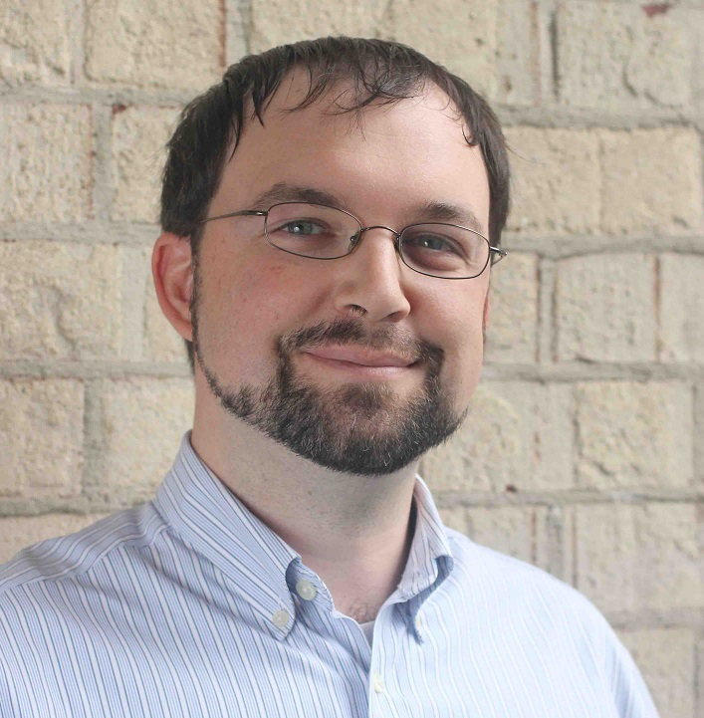

Instructors
Carnegie Mellon
Randy Bryant
Phil Gibbons
15-213/18-213
Lectures
Brian Railing
Martin Carlisle
15-513

Slide 33
15-213/18-213 and 15-513
Carnegie Mellon
15-213/18-213
Only undergraduates
Live lectures
Recitations
15-513
Only Masters students
Lectures by video (on the website and panopto)
Everything else is the same for all the courses

Slide 34
Textbooks
Randal E. Bryant and David R. O’Hallaron,
Computer Systems: A Programmer’s Perspective, Third Edition (CS:APP3e), Pearson, 2016
http://csapp.cs.cmu.edu
This book really matters for the course!
How to solve labs
Practice problems typical of exam problems
Brian Kernighan and Dennis Ritchie,
The C Programming Language, Second Edition, Prentice Hall, 1988
Still the best book about C, from the originators
Even though it does not cover more recent extensions of C

Slide 35
Course Components
Lectures
Higher level concepts
Labs (7)
The heart of the course
1-2+ weeks each
Provide in-depth understanding of an aspect of systems
Programming and measurement
Exams (midterm + final)
Test your understanding of concepts & mathematical principles

Slide 36
Getting Help
Carnegie Mellon
Class Web page: http://www.cs.cmu.edu/~213
Complete schedule of lectures, exams, and assignments
Copies of lectures, assignments, exams, solutions
FAQ
Piazza
Best place for questions about assignments
By default, your posts will be private
We will fill the FAQ and Piazza with answers to common questions
Blackboard
We won’t be using Blackboard for the course

Slide 37
Getting Help
Carnegie Mellon
Staff mailing list: 15-213-staff@cs.cmu.edu
Use this for logistical issues
Problems with accounts, etc.
Send email to individual instructors only to schedule appointments
Office hours (starting Tue Sep 6):
SMTWR, 5:30-7:30pm, WeH 5207
1:1 Appointments
You can schedule 1:1 appointments with any of the teaching staff

Slide 38
Policies: Labs And Exams
Work groups
You must work alone on all lab assignments
Handins
Labs due at 11:59pm
Electronic handins using Autolab (no exceptions!)
Exams
Exams will be online in network-isolated clusters
Held over multiple days. Self-scheduled; just sign up!
Appealing grades
Via detailed private post to Piazza within 7 days of completion of grading
Follow formal procedure described in syllabus

Slide 39
Facilities
Labs will use the Intel Computer Systems Cluster
The “shark machines”
linux> ssh shark.ics.cs.cmu.edu
21 servers donated by Intel for 213/513
10 student machines (for student logins)
1 head node (for instructor logins)
10 grading machines (for autograding)
Each server: Intel Core i7: 8 Nehalem cores, 32 GB DRAM, RHEL 6.1
Rack-mounted in Gates machine room
Login using your Andrew ID and password
Getting help with the cluster machines:
Please direct questions to staff mailing list

Slide 40
Timeliness
Grace days
5 grace days for the semester
Limit of 0, 1, or 2 grace days per lab used automatically
Covers scheduling crunch, out-of-town trips, illnesses, minor setbacks
Lateness penalties
Once grace day(s) used up, get penalized 15% per day
No handins later than 3 days after due date
Catastrophic events
Major illness, death in family, …
Formulate a plan (with your academic advisor) to get back on track
Advice
Once you start running late, it’s really hard to catch up
Try to save your grace days until the last few labs

Slide 41
Other Rules of the Lecture Hall
Laptops: permitted
Electronic communications: forbidden
No email, instant messaging, cell phone calls, etc
Presence in lectures (213): voluntary, recommended
No recordings of ANY KIND

Slide 42
Policies: Grading
Exams (50%): midterm (20%), final (30%)
Labs (50%): weighted according to effort
Final grades based on a straight scale (90/80/70/60) with a small amount of curving
Only upward

Slide 43
Programs and Data
Topics
Bit operations, arithmetic, assembly language programs
Representation of C control and data structures
Includes aspects of architecture and compilers
Assignments
L1 (datalab): Manipulating bits
L2 (bomblab): Defusing a binary bomb
L3 (attacklab): The basics of code injection attacks

Slide 44
The Memory Hierarchy
Topics
Memory technology, memory hierarchy, caches, disks, locality
Includes aspects of architecture and OS
Assignments
L4 (cachelab): Building a cache simulator and optimizing for locality.
Learn how to exploit locality in your programs.

Slide 45
Exceptional Control Flow
Topics
Hardware exceptions, processes, process control, Unix signals, nonlocal jumps
Includes aspects of compilers, OS, and architecture
Assignments
L5 (tshlab): Writing your own Unix shell.
A first introduction to concurrency

Slide 46
Virtual Memory
Topics
Virtual memory, address translation, dynamic storage allocation
Includes aspects of architecture and OS
Assignments
L6 (malloclab): Writing your own malloc package
Get a real feel for systems-level programming

Slide 47
Networking, and Concurrency
Topics
High level and low-level I/O, network programming
Internet services, Web servers
concurrency, concurrent server design, threads
I/O multiplexing with select
Includes aspects of networking, OS, and architecture
Assignments
L7 (proxylab): Writing your own Web proxy
Learn network programming and more about concurrency and synchronization.

Slide 48
Lab Rationale
Each lab has a well-defined goal such as solving a puzzle or winning a contest
Doing the lab should result in new skills and concepts
We try to use competition in a fun and healthy way
Set a reasonable threshold for full credit
Post intermediate results (anonymized) on Autolab scoreboard for glory!

Slide 49
Autolab (https://autolab.andrew.cmu.edu)
Labs are provided by the CMU Autolab system
Project page: http://autolab.andrew.cmu.edu
Developed by CMU faculty and students
Key ideas: Autograding and Scoreboards
Autograding: Providing you with instant feedback.
Scoreboards: Real-time, rank-ordered, and anonymous summary.
Used by over 3,000 students each semester
With Autolab you can use your Web browser to:
Download the lab materials
Handin your code for autograding by the Autolab server
View the class scoreboard
View the complete history of your code handins, autograded results, instructor’s evaluations, and gradebook.
View the TA annotations of your code for Style points.

Slide 50
Autolab accounts
Students enrolled 1:00pm on Mon, Aug 29 have Autolab accounts
You must be enrolled to get an account
Autolab is not tied in to the Hub’s rosters
If you add in, contact 15-213-staff@cs.cmu.edu for an account
We will update the autolab accounts once a day, so check back in 24 hours.
For those who are waiting to add in, the first lab (datalab) will be available on the Schedule page of the course Web site.

Slide 51
Waitlist questions
15-213: Catherine Fichtner (cathyf@cs.cmu.edu)
18-213: Zara Collier (zcollier@andrew.cmu.edu)
15-513: Catherine Fichtner (cathyf@cs.cmu.edu)
Please don’t contact the instructors with waitlist questions.

Slide 52
Welcome and Enjoy!

